Slide 1


Design Thinking and Innovation (CSET210)
Problem Statement
ExploreEase – AI‑Powered Travel Planner
Theme: Simplifying Travel Planning with AI
Team ID: 06
Mentor
Dr. Gulshan Shrivastava
Our team is guided by Dr. Shrivastava. His expertise is invaluable to our project.
Dr. Shrivastava has provided guidance and support throughout our journey. His insights helped shape our AI travel planner.

Slide 2





Our Team Members & Roles
Bhanuteja Padamata
Role: AI Model Development & Frontend Support
Designed AI system and integrated OpenRouter API.
V S Santhosh
Role: Backend Developer & System Integrator
Developed backend using Node.js and integrated MySQL database.
Shubham Pandey
Role: Frontend UI/UX Designer & Data Flow Architect
Built responsive interface using React.js and TypeScript.
Maligi Yashika
Role: Data Collection & Integration & User Journey Mapping
Handled data gathering and designed the user journey.

Slide 3
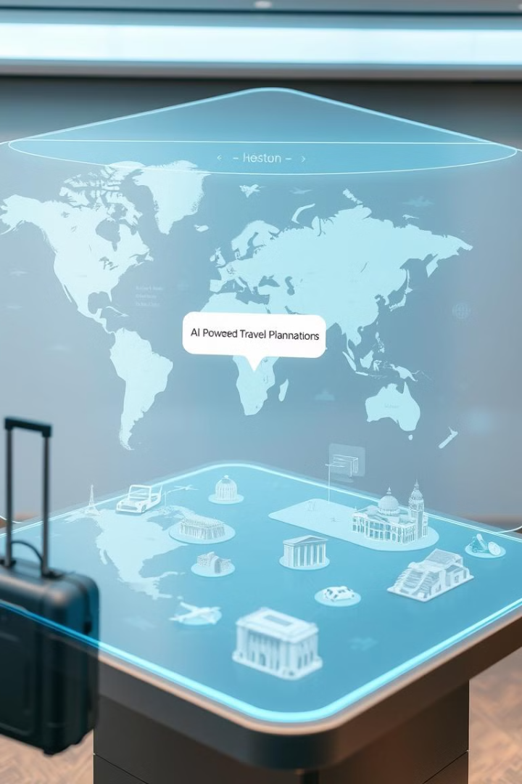
ExploreEase – AI-Powered Travel Planner
Transforming Travel Planning with AI.
ExploreEase is your smart companion for hassle-free travel planning. Our AI-powered platform creates personalized itineraries, optimizes budgets, and provides seamless booking assistance.

Slide 4
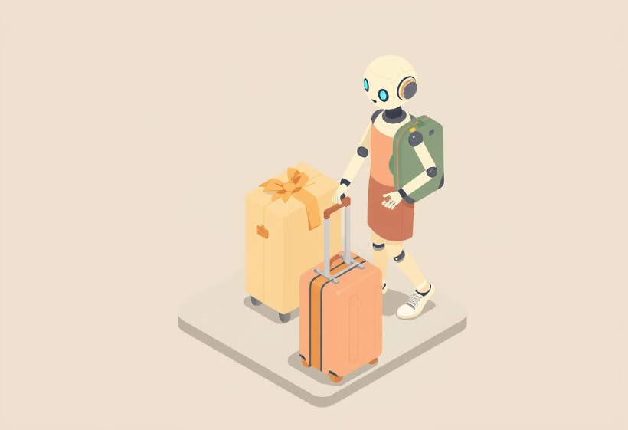

Your Smart Travel Companion
Introducing ExploreEase
ExploreEase revolutionizes travel planning with AI. We offer personalized itineraries and hassle-free booking assistance.
Your Smart Companion for Hassle-Free Travel Planning.

Slide 5




The Travel Planning Problem
Time-Consuming
Overwhelming Choices
Hours spent researching destinations and itineraries.
Too many options lead to decision paralysis.
Lack of Personalization
Generic recommendations don't fit unique preferences.
Did you know? Travelers spend an average of 20 hours planning a single trip.

Slide 6
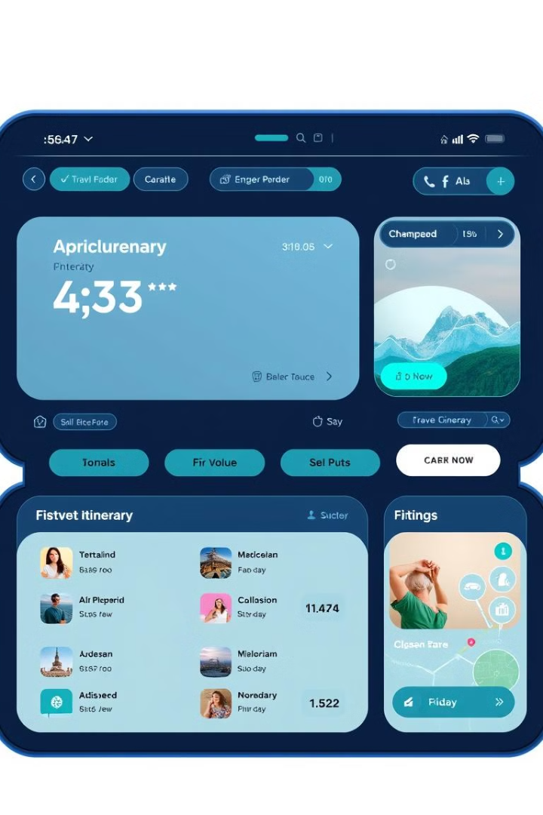
The ExploreEase Solution
AI-Powered Itinerary Planning
Intelligent trip generation based on your preferences.
Personalized Recommendations
Tailored suggestions for attractions, dining, and lodging.
Budget Optimization
Smart expense tracking to maximize travel funds.
ExploreEase solves these issues with AI-driven solutions.

Slide 7
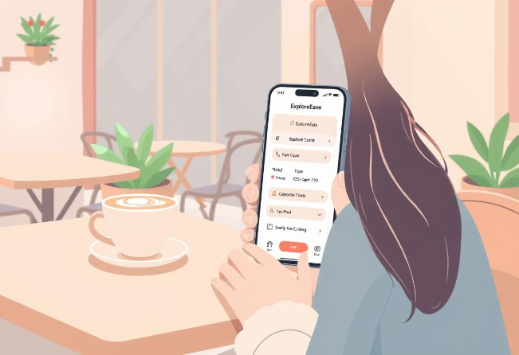




How ExploreEase Works
Input Preferences
AI Generates Itinerary
Tell us your travel style and interests.
Receive a custom-made travel plan.
Booking Recommendations
Seamless Travel
Seamlessly book flights, hotels, and activities.
Enjoy a stress-free travel experience.
A step-by-step user journey for hassle-free travel.

Slide 8





ExploreEase Key Features
Personalized Itineraries
Real-time Price Comparisons
Smart Budgeting
Integrated Booking
Travel Guides
Discover hidden gems with expert travel tips.

Slide 9

Stakeholders & Target Users
Stakeholders
Target Users
Travelers, agencies, API providers,
investors supporting growth
Frequent, budget-conscious, first timers, corporate & solo adventurers

Slide 10
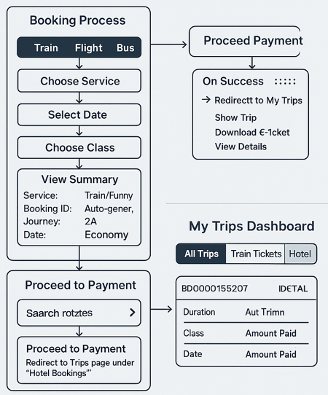
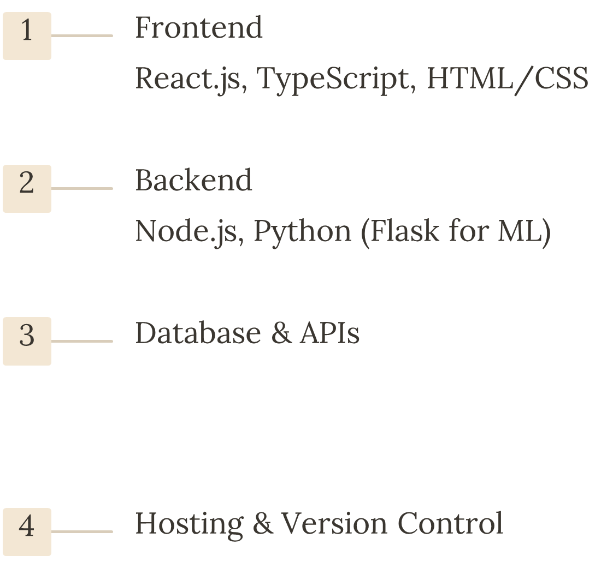
ExploreEase System Architecture
MySQL, Goibibo

Slide 11
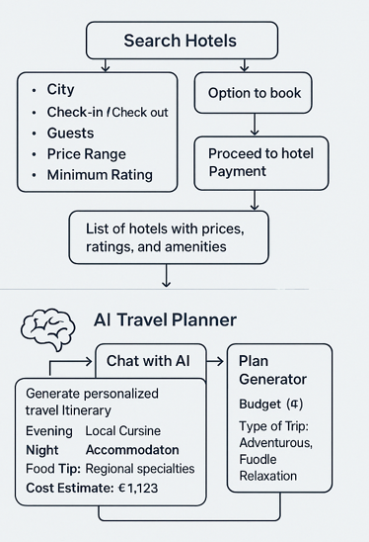



UI/UX Design Highlights
Responsive & Intuitive
Accessible design across devices with easy navigation
Interactive Tools
Drag & drop itinerary builder with helpful filters
AI Chatbot & Management
Chatbot guidance plus seamless booking and profile setup

Slide 12
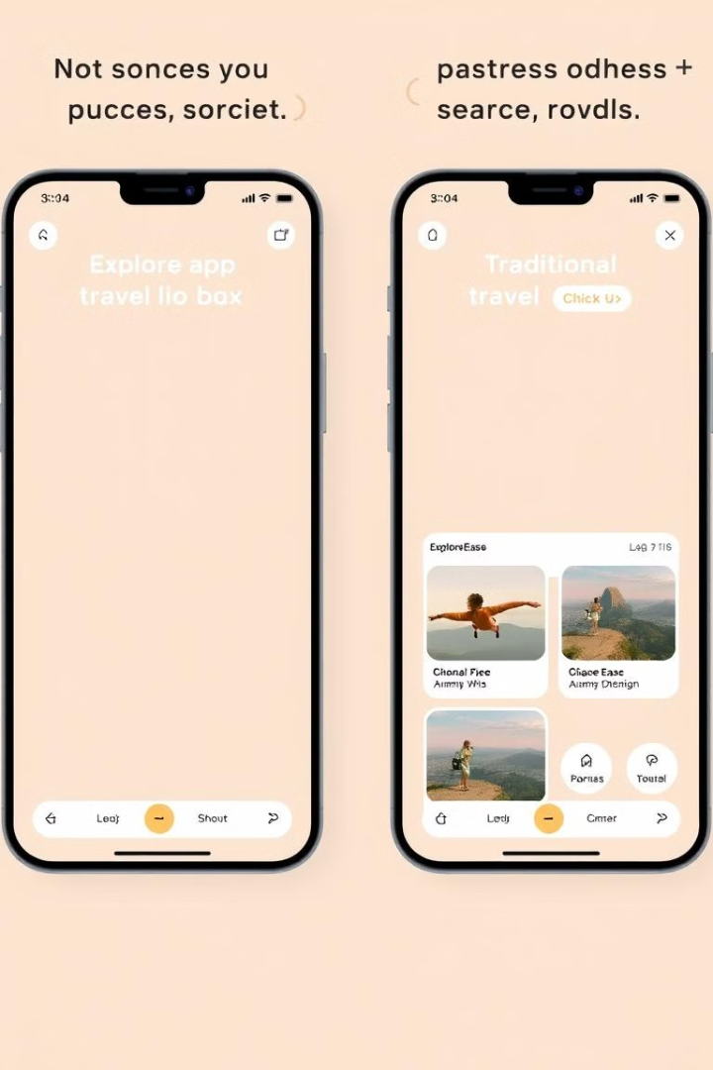
ExploreEase vs Traditional Apps
Itinerary Planning
AI-Powered
Manual
Personalization
Highly Personalized
Limited
Price Comparison
Real-Time
Delayed
Experience the unique AI-driven advantage.

Slide 13








Our Target Audience
Business Travelers
Backpackers
Efficient and reliable travel solutions.
Budget-conscious explorers looking for value.
Solo Travelers
Families
Independent adventurers seeking unique experiences.
Easy and stress-free vacation planning.

Slide 14
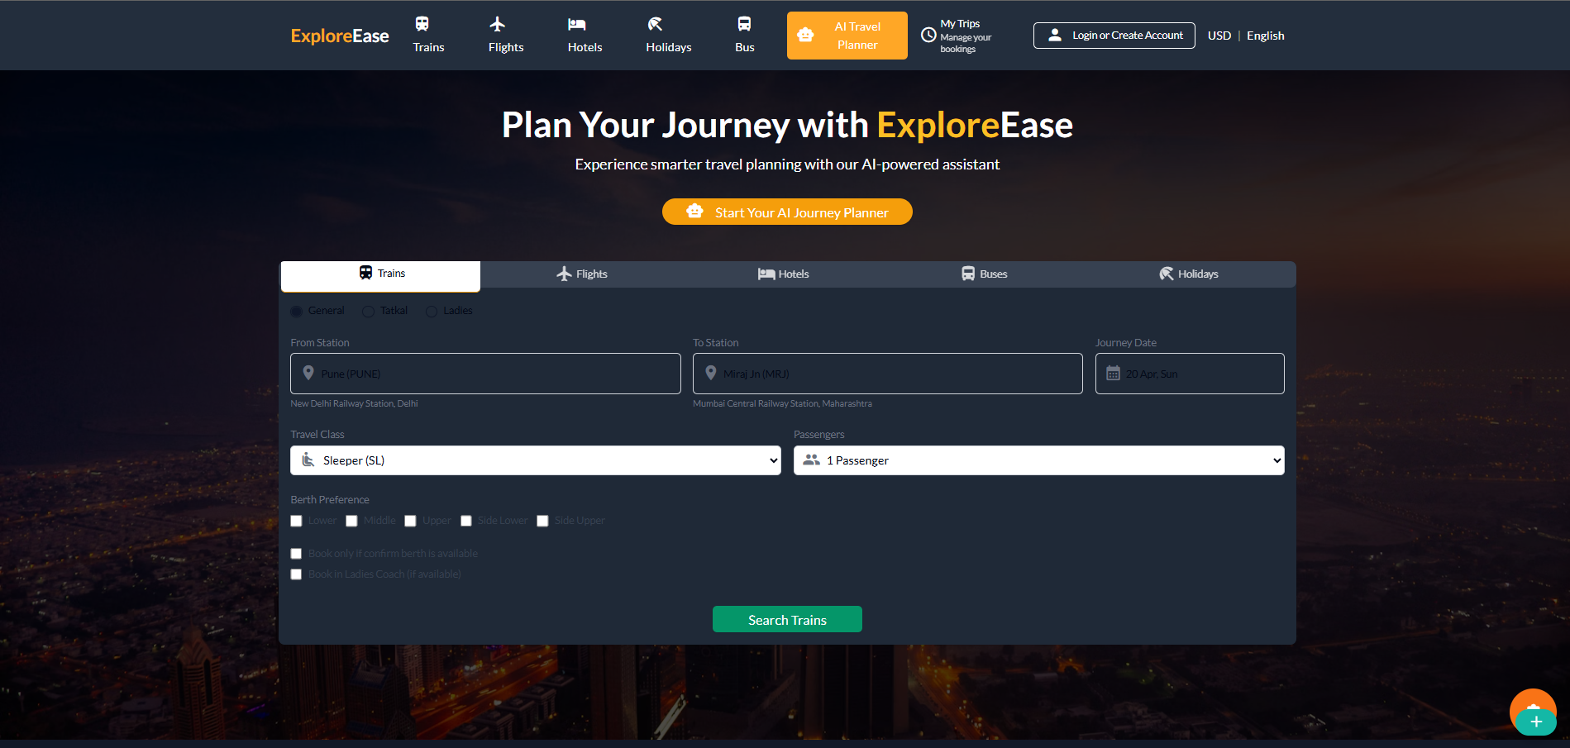
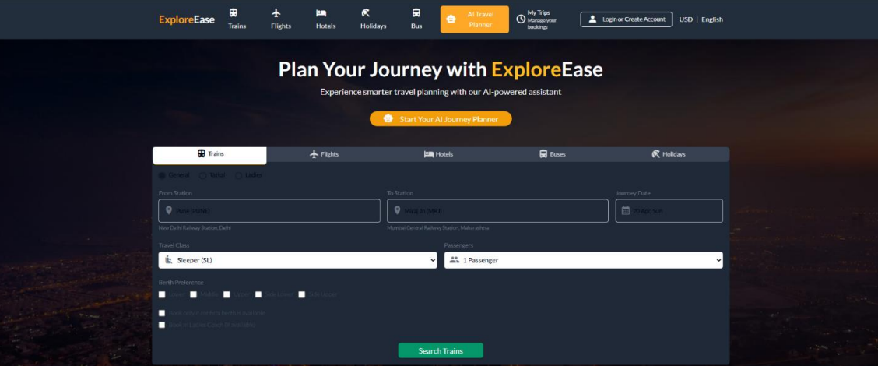

Core Functionality Overview
User Input
Data Fetching
1
Collect preferences and details
2
Integrate real-time APIs
Itinerary Generation
Real-time Updates
3
Use ML to create optimized plans
4
Adjust plans for weather, prices, and events

Slide 15

Future Enhancements
Multi-Language Support
Augmented Reality (AR)
Catering to a global audience with diverse languages.
Immersive travel experiences with AR technology.
AI-Powered Real-Time Assistance
Intelligent support throughout your journey.

Slide 16
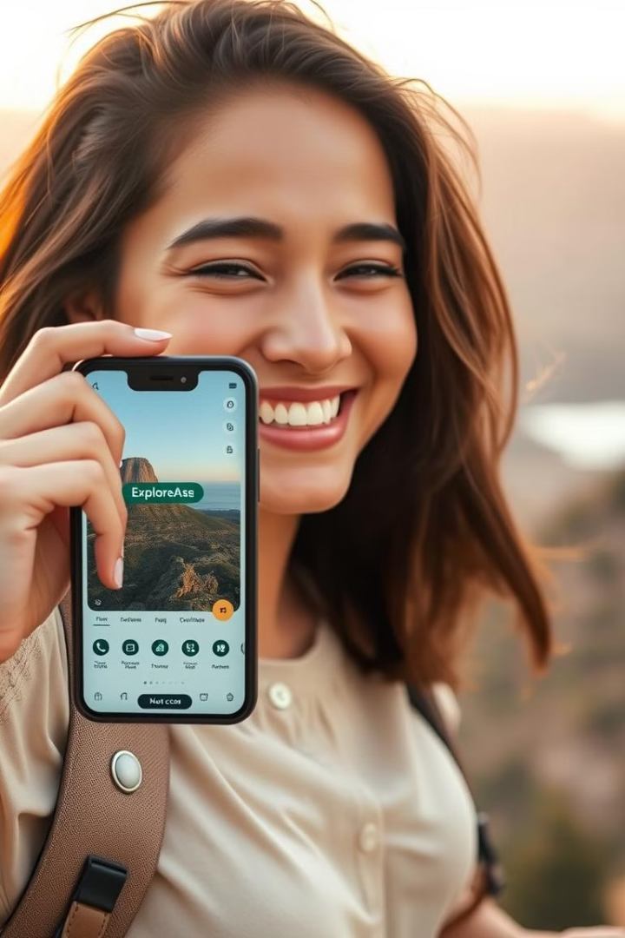
Explore Smarter with ExploreEase!
Recap: ExploreEase transforms travel planning with AI. Key benefits: Personalized itineraries and budget optimization. Let’s Explore Smarter with ExploreEase!

